Slide 1

InsuranceSuite 10 Fundamentals
Guidewire Digital Products using InsuranceSuite

Slide 2
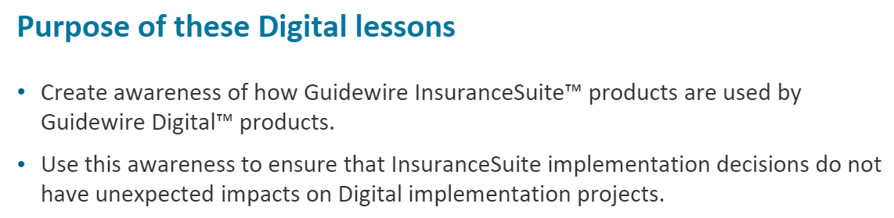

Slide 3

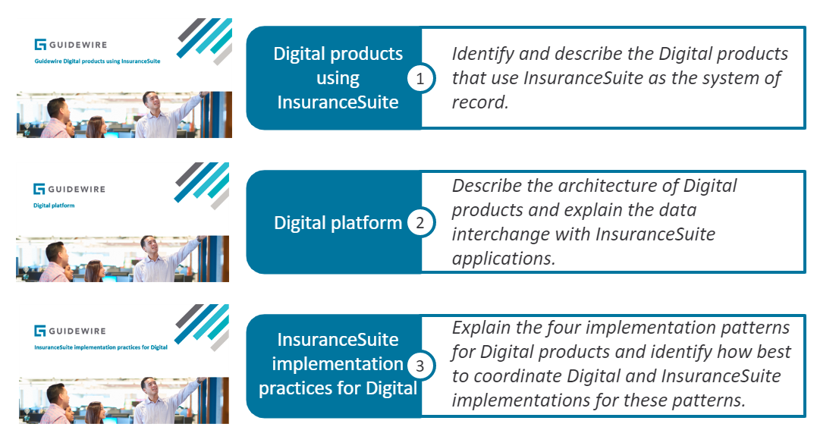

Slide 4
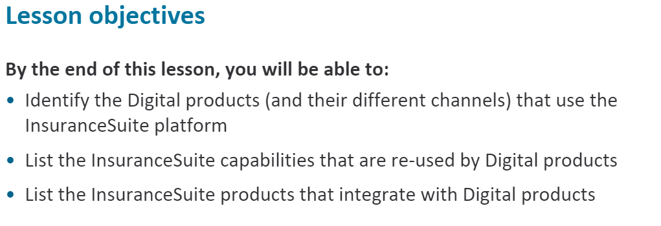

Slide 5
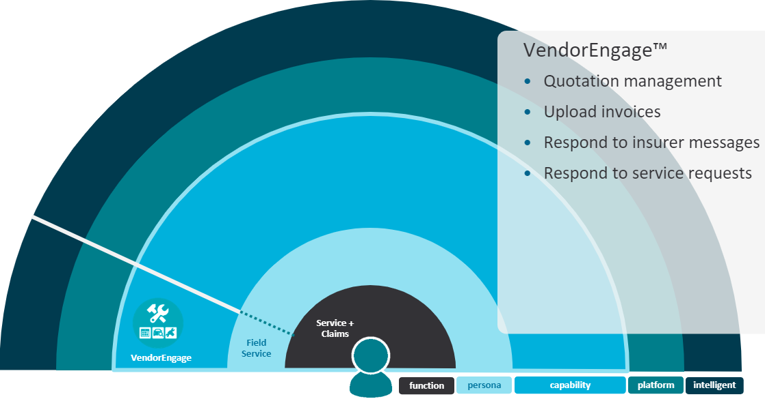
Notes:
The first product you will investigate allows vendors such as construction workers, motor trade professionals or medical professionals use Vendor Engage to respond to claim-related service requests and can :
1. Provide and manage quotes for services
2. Upload documentation such as invoices to service requests
3. Respond to insurer messages
4. Respond to service requests

Slide 6
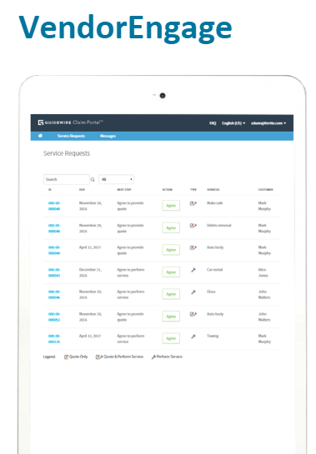
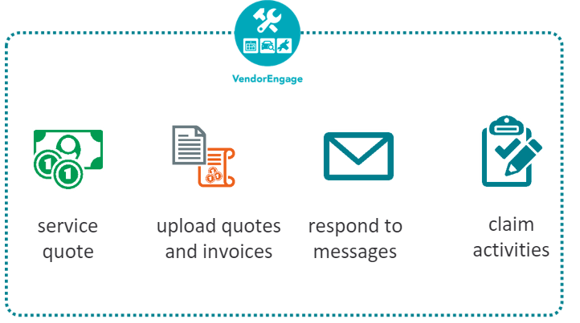
Notes:
Using VendorEngage, vendors can manage service requests:
Provide and manage quotes for services
Upload documentation such as invoices to service requests
Respond to insurer messages
Respond to service requests

Slide 7
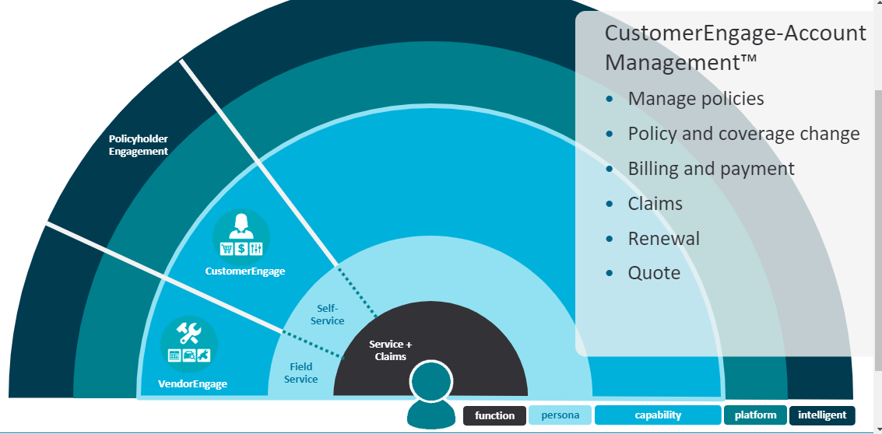
Notes:
Policyholders use CustomerEngage-Account Management to be self- sufficient when managing their accounts and policies.
They can:
Manage policies
Make changes to a policy's
personal details and
coverage s
Manage an account's
billing and payments
File claims
Renew policies
Requesting quotes

Slide 8
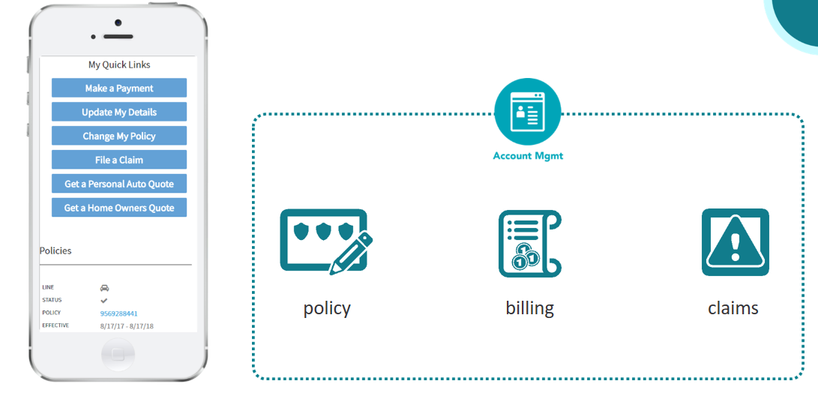
Notes:
Policyholders use CustomerEngege-Account Management for common account and policy transactions, such as managing policies, billing end payments, claims and requesting quotes. For quote requests initiated in CustomerEngege-Account Management, quotes will be completed in CustomerEngege-Quote and Buy.

Slide 9
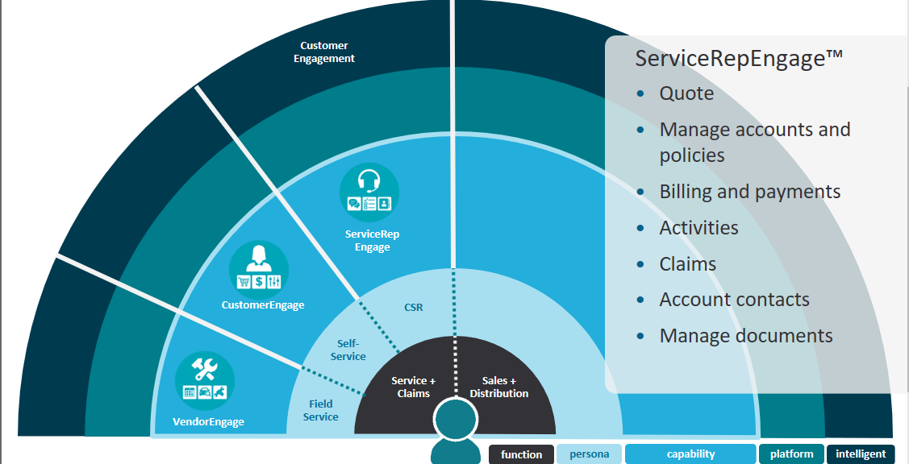
Notes:
Customer service representatives use ServiceRepEngage, to
Make inquiries on policyholder quotes, accounts and policies.
Bind quote requests, check a policyholder account's standing and take payments for an account.
Manage customer service representative activities and add notes to document CSR- policyholder conversations,
File claims and view a policyholder's claims history and View contacts associated with an account
Upload policy documentation for claims, quotes and policies

Slide 10

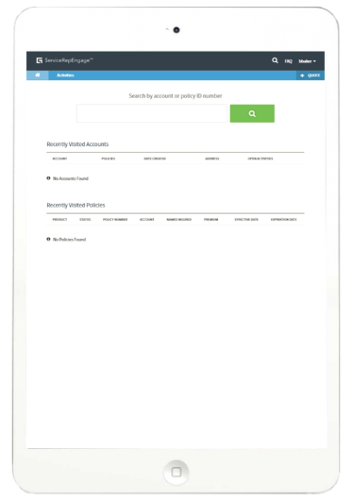
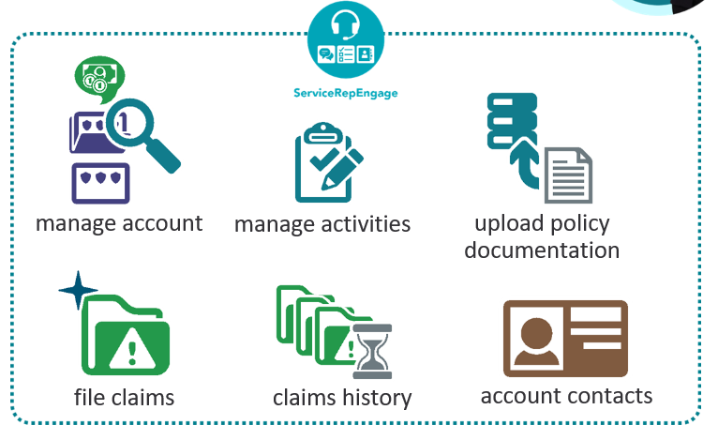
Notes:
Note that ServiceRepEngage and ProducerEngage are almost the same codebase and features. Each just supports a different persona, so the view on the data is different. In ServiceRepEngage, customer service representatives can help policyholders with inquiries such as policy changes, getting quotes and file and manage claims.
Customer Service Representatives use ServiceRepEngage to:
Make inquiries on policyholder quotes, accounts and policies.
Bind quote requests, check a policyholder account's standing and take payments for an account.
Manage customer service representative activities and add notes to document CSR- policyholder conversations,
Upload policy documentation for claims, quotes and policies,
File claims and view a policyholder's claims history and
Use contacts associated with an account for upsell opportunities

Slide 11

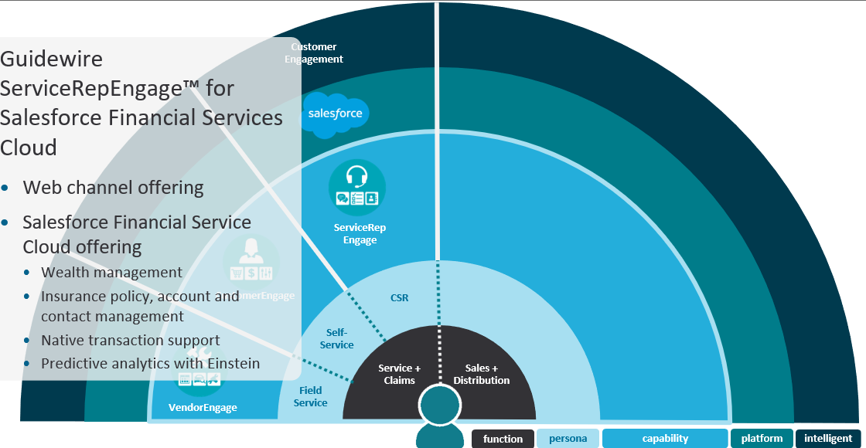
Notes:
ProducerEngage and ServiceRepEngage are both available as a traditonal web channel offering and also as a product that is fully integrated with Salesforce Financial Services Cloud.
ServiceRepEngagew for Salesforce Financial Services Cloud utilizes Salesforce Financial Services Cloud's native support for financial
and wealth management transactions and accumulates insurance premiums at the account level, while also using account relationships to empower customer service representatives to drive sales leads.

Slide 12
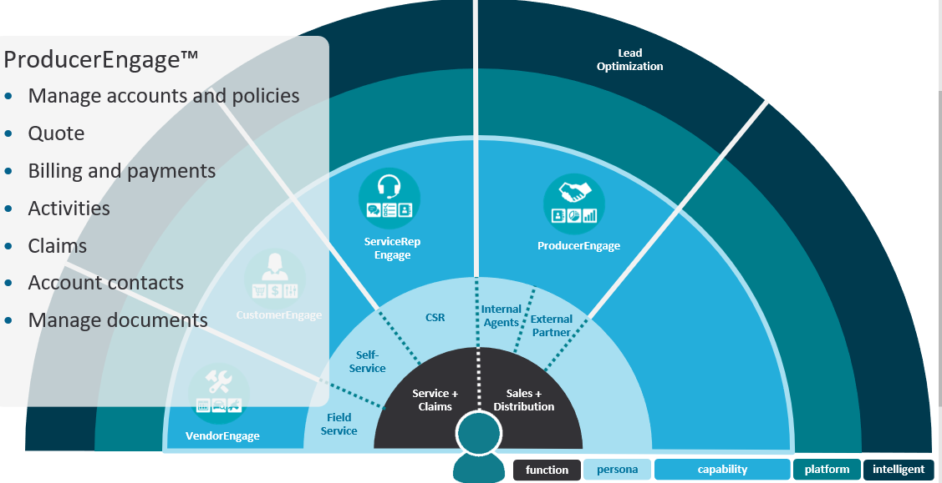
Notes:
Agents use ProducerEngage to:
Manage accounts and policies
Request quotes
Bind quote requests, check a policyholder account's standing and take payments for an account.
Manage agent activities and add notes to document agent- policyholder conversations
File claims and view a policyholder's claims history
View an account's related contacts
Upload policy documentation

Slide 13

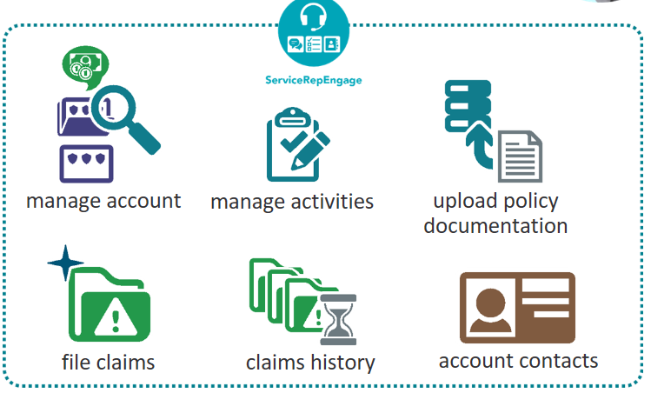
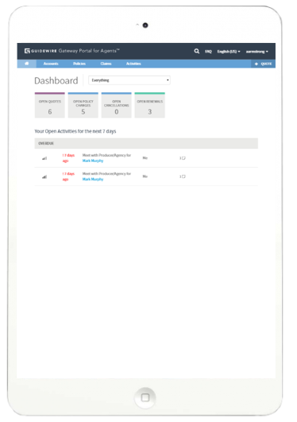
Notes:
Note that ServiceRepEngage and ProducerEngage are almost the same codebase and features. Each just supports a different persona,
so the view on the data is different.
Agents use ProducerEngage to:
Create accounts
Manage policies — view policy summaries, policy endorsement (also referred to as a mid-term adjustment) which includes coverage changes, renewals and upload policy documents
Manage agent activities and add notes to document agent- policyholder conversations
File claims and view a policyholder's claims history
Use contacts associated with an account for upsell opportunities

Slide 14
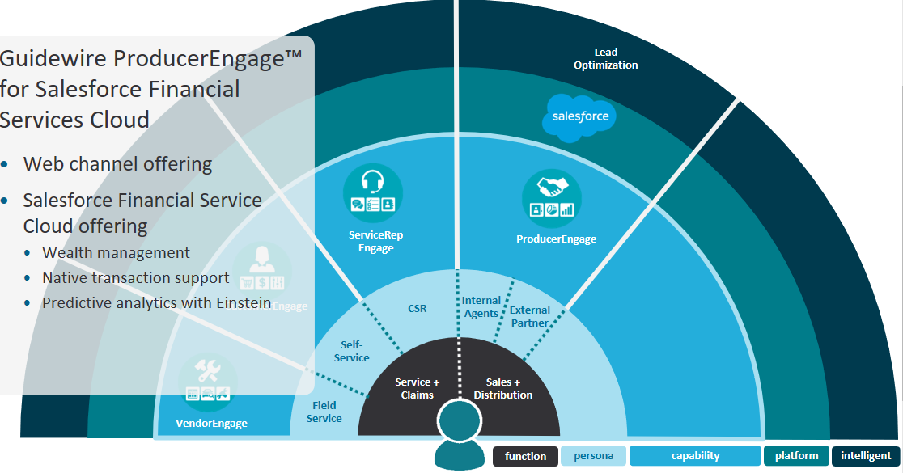
Notes:
ProducerEngagew for Salesforce Financial Services Cloud utilizes Salesforce Financial Services Cloud's native support for financial
and wealth management transactions and accumulates insurance premiums at the account level, while also using
account relationships to empower captive agents to drive sales leads.
Having products that integrate with Salesforce Financial Services Cloud enables insurers make full use of Salesforce Einstein for deeper portfolio insights and predictive analytics across an insurer's entire book of business.

Slide 15
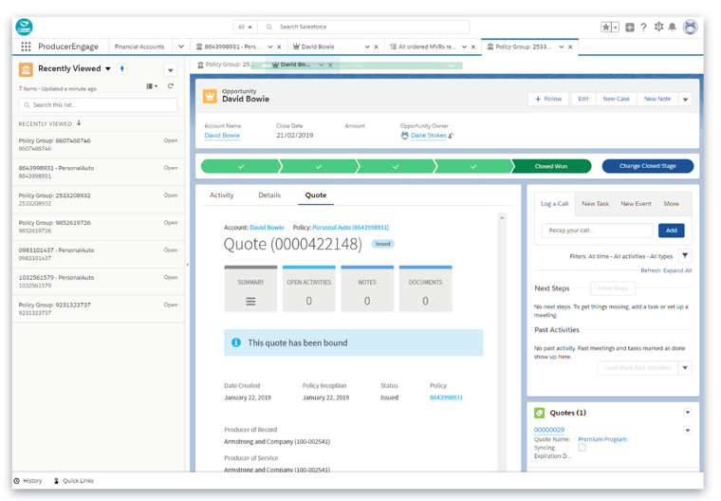
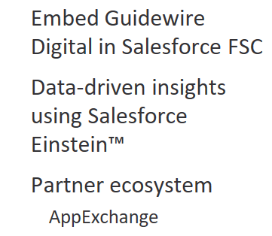
Notes:
ProducerEngagew for Salesforce Financial Services Cloud and ServiceRepEngagew for Salesforce Financial Services Cloud (referred to here as xEngage for Salesforce FSC) provide another channel where insurers can embed their insurance portfolio within the Salesforce Financial Services Cloud ecosystem.
By embedding Guidewire Digital products into Salesforce Financial Service Cloud, insurers can leverage Salesforce Einstein to gain
insights on customer behaviors and solve specific business challenges and also engage with the partner ecosystem through Salesforce AppExchange.
These two Digital products empower captive agents and customer service representatives , respectively to manage accounts, contacts, products and conveniently create and manage quotes and opportunities

Slide 16
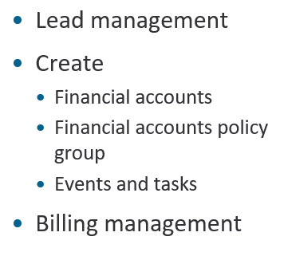
Notes:
ProducerEngagew for Salesforce Financial Services Cloud and for Salesforce Financial Services Cloud facilitate a 360 view includes data synchronizations for:
Guidewire systems (PC, BC, CC)
Non-Guidewire systems (e.g., legacy P&C, life)
CSRs and captive agents, respectively can create leads, opportunities and financial accounts in each of these applications. Financial accounts are analogous to PolicyCenter accounts. Financial accounts of type policy group map to PolicyCenter policies.
These applications use Salesforce and PolicyCenter integrations to support quotes, renewals and policy changes for homeowners
and personal auto lines of business CSRs and captive agents can access a financial account or financial account policy group's billing details and can also create tasks and events for these objects. Next, you will learn about CustomerEngage-Quote and Buy.

Slide 17

Notes:
Prospective policyholders can get a quote, create a quote submission, retrieve their existing quote submissions and bind policies and submit payment.
Small-to-medium business owners often require multiple policies and this requires careful consideration often in the absence of relevant informaton or time to research insurance products.
Guidance to Product is a feature with small to medium business owners in mind, for example, a dentist's practice, or a
barber shop for example. These users often need additional support to navigate industry jargon and identify the correct
insurance product for their business.
Prospective policyholders can visually compare the different product offerings
side-by-side and objectively compare each in terms of their respective coverages.
These policyholders can modify coverages and recalculate quotes inline.

Slide 18

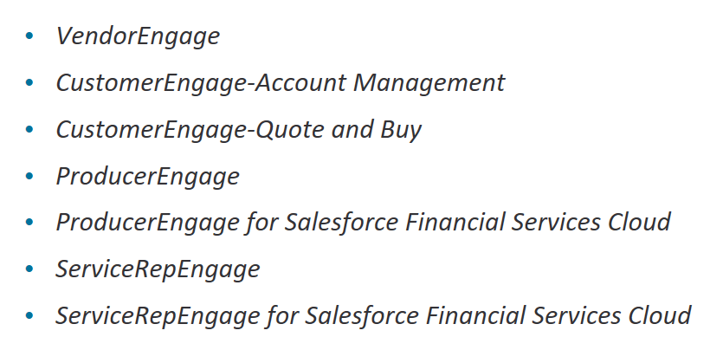

Slide 19
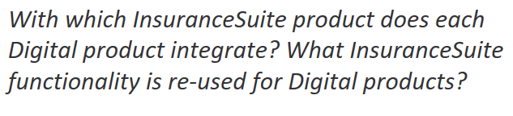

Slide 20
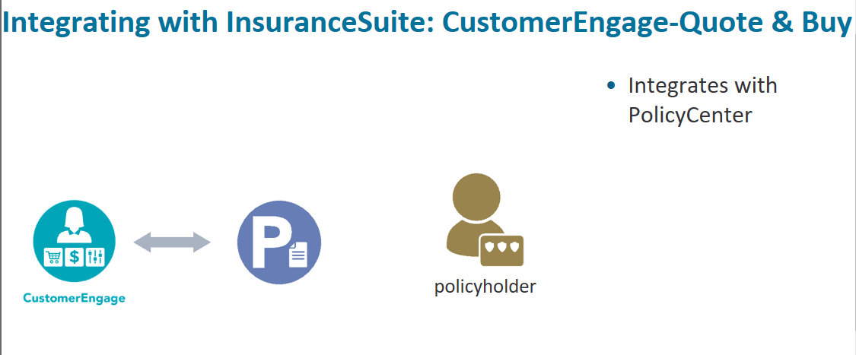
Notes:
For policyholders, digital sales are accessed through CustomerEngage-Quote and Buy which is pre-integrated with PolicyCenter.

Slide 21
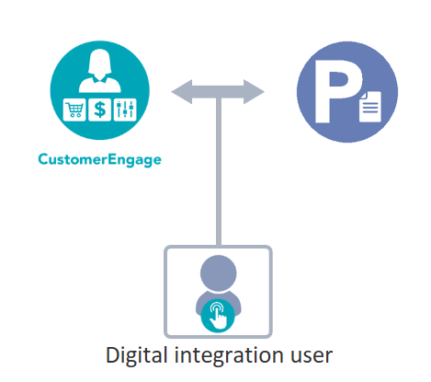
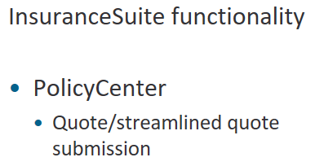
Notes:
The first integration point with PolicyCenter is the Digital integration user. Calls to InsuranceSuite APIs are made using the Digital integration user which has the minimum required permissions required for the digital application.
CustomerEngage-Quote and Buy leverages PolicyCenter quote submission via the Digital integration user.
CustomerEngage-Quote and Buy can be used by anonymous users and does not require that a digital product user has an account
or associated privileges to generate a quote.

Slide 22
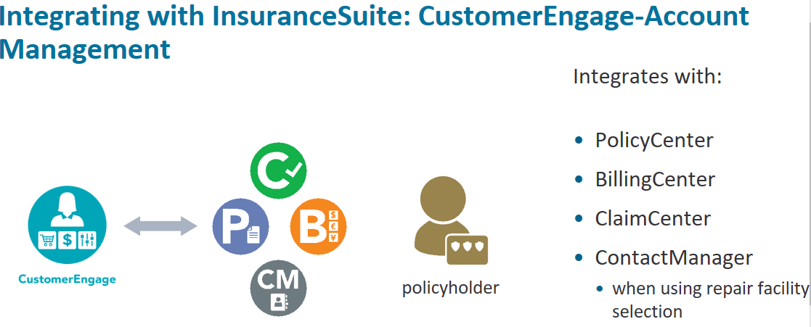
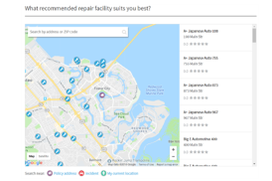
Notes:
Digital account service is enabled through CustomerEngage-Account Management which is pre- integrated with PolicyCenter,
BillingCenter and ClaimCenter.
This allows policyholders to:
Notify insurance providers of contact information changes,
Pay invoices and set up payment schedules
File claims
Service their accounts without having to reach out to a call center
When using the repair facility selection feature for claims, CustomerEngage-Account Management requires access to ContactManager.

Slide 23
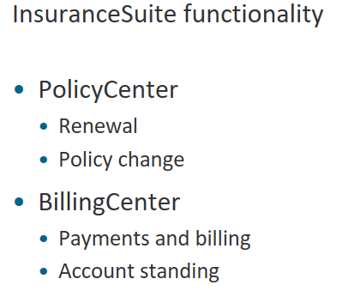
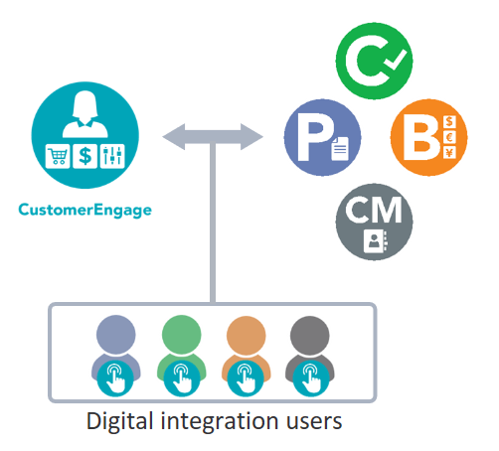
Notes:
CustomerEngage-Account Management requires a Digital integration user for each InsuranceSuite application, each sufficiently
authorized for calls to their respective InsuranceSuite's APIs.
CustomerEngage-Account Management requires integration users for PolicyCenter, BillingCenter, ClaimCenter and ContactManager.
ContactManager is only required when the repair selection feature is enabled for claims.
These PolicyCenter transactions are re-used:
Renewal
Cancellation
Policy change
The following BillingCenter functionality is built into CustomerEngage-Account Management:
Payments and billing
Account standing

Slide 24
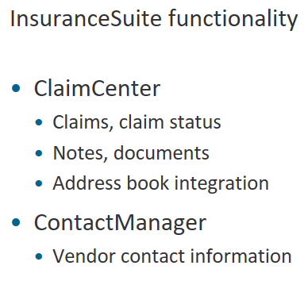
Notes:
The foIlowing ClaimCenter functionality is re-used in CustomerEngage-Account Management:
Claims
Claim notes
Claim documents
CustomerEngage-Account Management uses vendor contact information from ContactManager when the repair facility selection feature is enabled for claims.
CustomerEngage-Account Management requests vendor's contact details that are in close proximity to either the policy address, the claim incident location for (personal auto only) or the policyholder's current location.

Slide 25
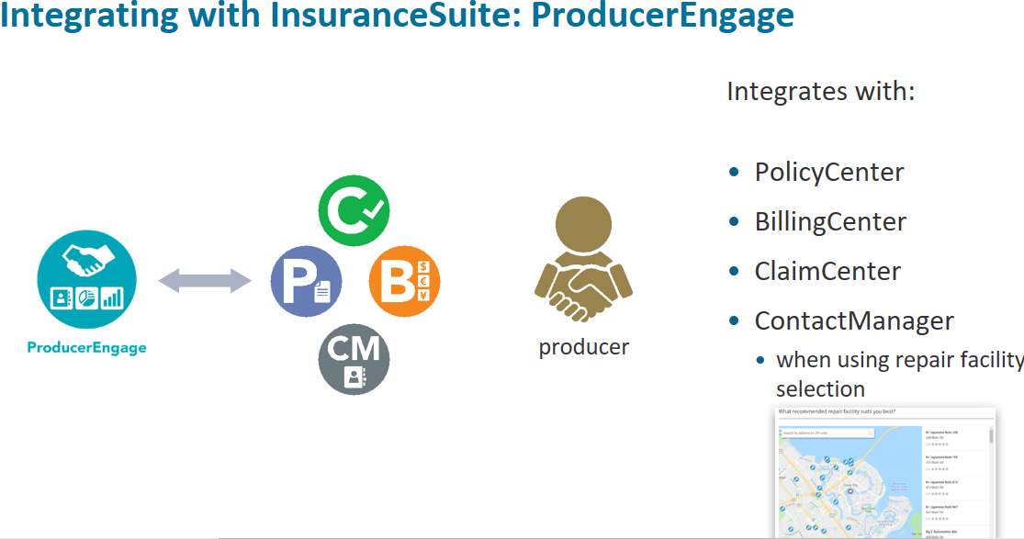
Notes:
ProducerEngage in its basic configuration requires a bidirectional connection to PolicyCenter, BillingCenter and ClaimCenter. ProducerEngage can also be configured with claims only or billing only in which case ClaimCenter or BillingCenter are part of the
implementation or both to run ProducerEngage with claims and billing.
When using the repair facility selection feature for claims, ProducerEngage requires access to ContactManager.

Slide 26
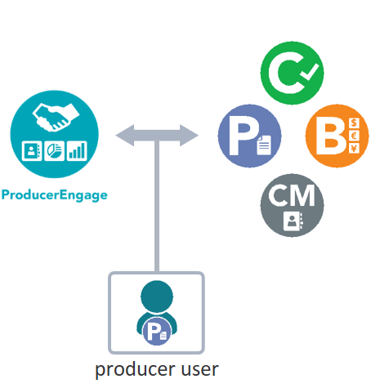
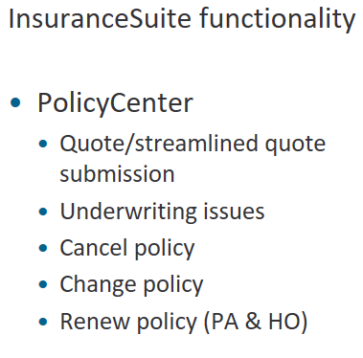
Notes:
ProducerEngage calls to PolicyCenter APIs directly using any account with a producer role assigned. Any producer account can login to ProducerEngage and call InsuranceSuite APIs like a native user.
ProducerEngage uses PolicyCenter functionality such as :
Quote
Llnderwriting issue
Policy transactions:
cancel
change
renewal
Policy renewals are only performed natively in ProducerEngage for homeowners and personal auto lines. For other business
lines renewals are delegated to PolicyCenter.

Slide 27
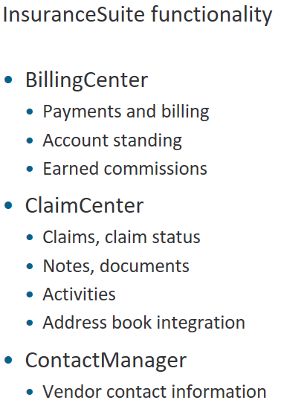

Slide 28
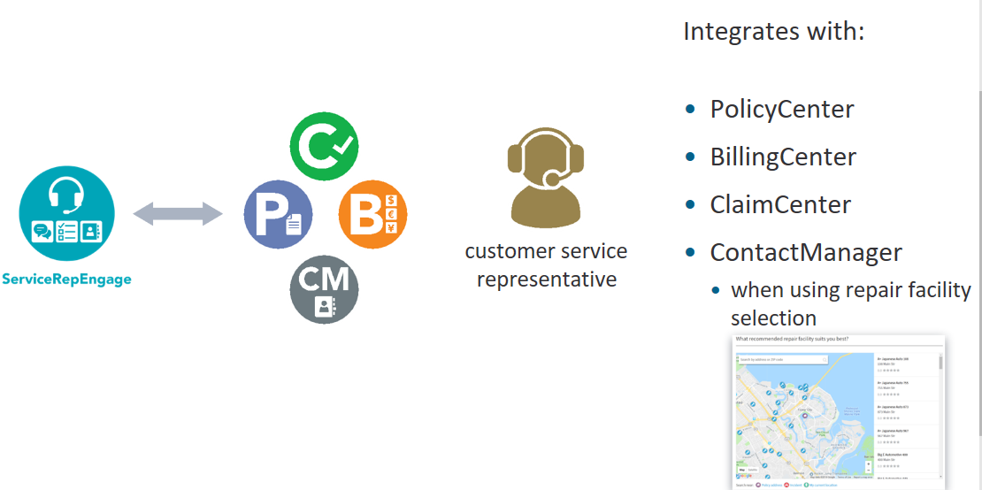
Notes:
ServiceRepEngage allows an insurer's customer service representatives to assist policyholders manage their policies, from billing to claims to upselling, renewals and policy changes or cancellation. ServiceRepEngage works with PolicyCenter, BillingCenter and
ClaimCenter.
When using the repair facility selection feature, ServiceRepEngage requires access to ContactManager.

Slide 29
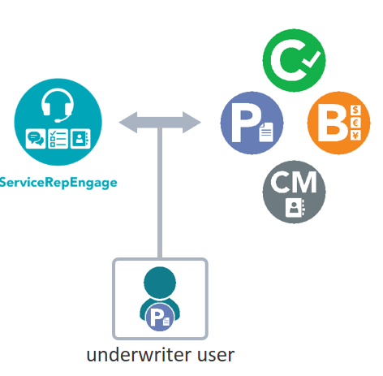
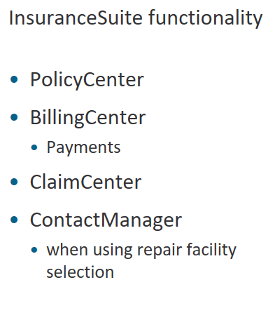
Notes:
ServiceRepEngage calls to PolicyCenter APIs directly using any account with the underwriter role assigned. Any underwriter account can login to ServiceRepEngage and call InsuranceSuite APIs as a native user.

Slide 30

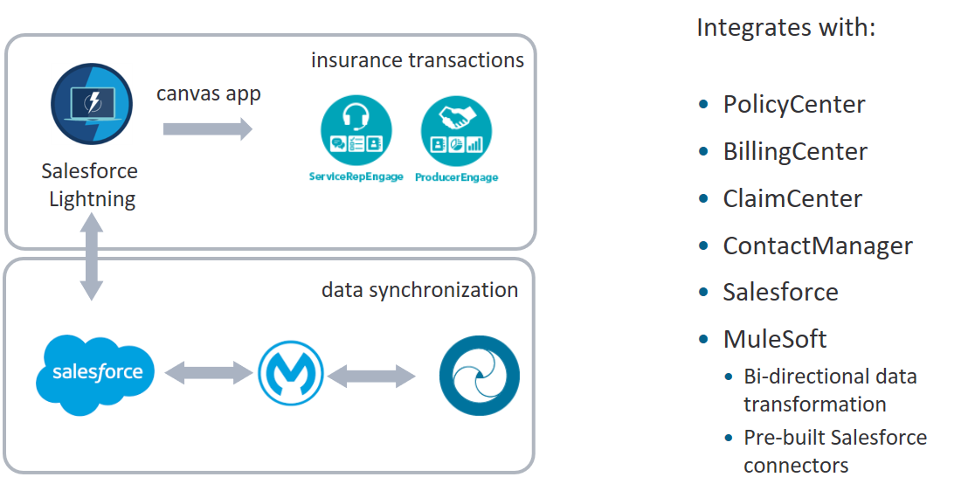
Notes:
ProducerEngage/ServiceRepEngage for Financial Services Cloud are pre-integrated with BillingCenter, ClaimCenter, PolicyCenter and ContactManager (if required).
These applications require bidirectional synchronization of data between Salesforce Financial Services Cloud and InsuranceSuite.
Mule is the middleware component that orchestrates transformation of PolicyCenter data to Salesforce FSC and from Salesforce FSC to PolicyCenter. Mule enterprise service bus decouples InsuranceSuite from Salesforce using pre-built Salesforce connectors.

Slide 31
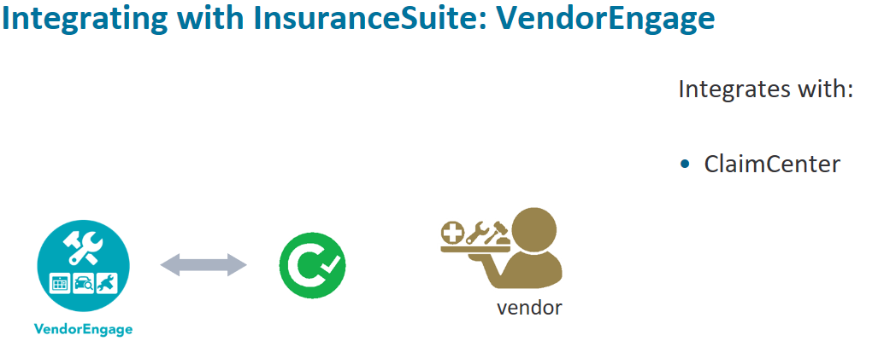
Notes:
VendorEngage requires a sufficiently-authorized integration user in ClaimCenter to use ClaimCenter APIs in VendorEngage.

Slide 32
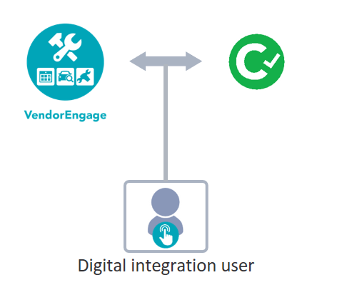
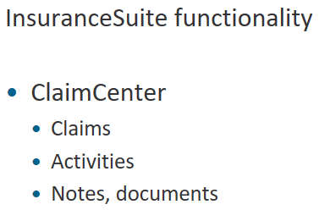
Notes:
VendorEngage uses claims, service requests, notes and document management Now, check what you have learned.

Slide 33
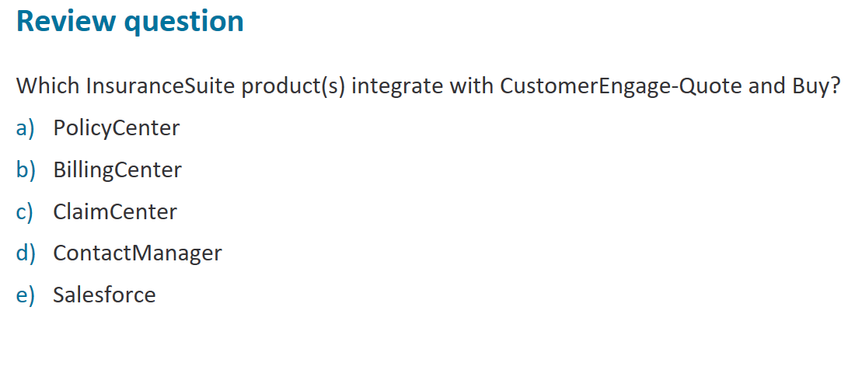

Slide 34
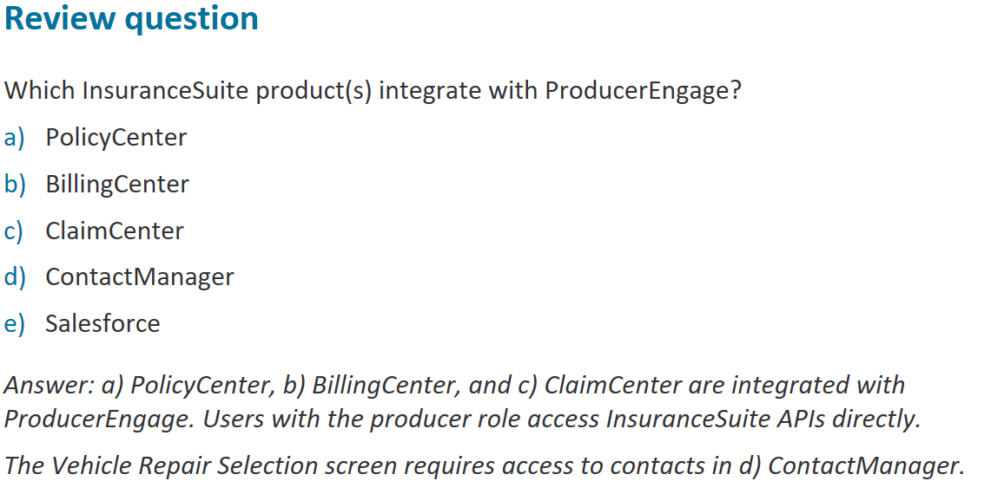

Slide 35
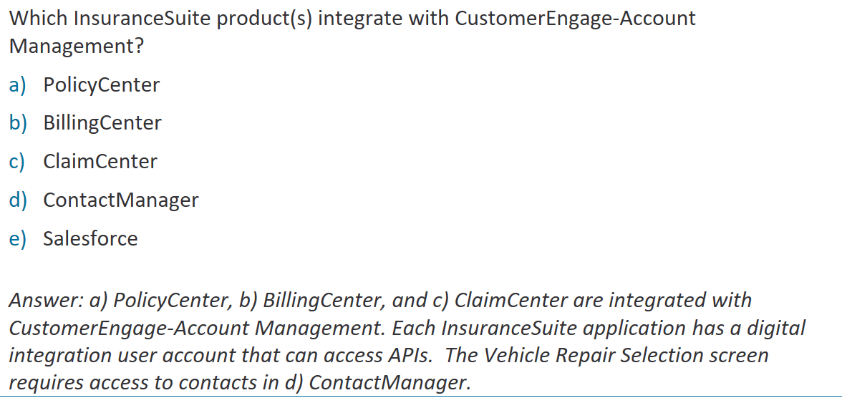

Slide 36

